Slide 1

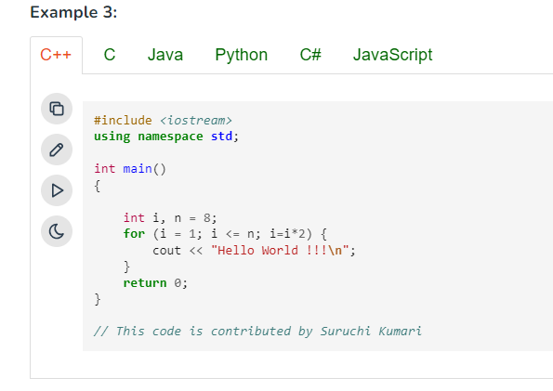

TODO BEFORE
Preparation before next session
You will need to present your research during the next session
LEARN
RESEARCH
Read this guide about algorithm complexity
Make researches on the following points
Q1 – What does the time complexity means ?
Q2 – What are the impacts of an algorithm with a Hight complexity ?

Slide 2
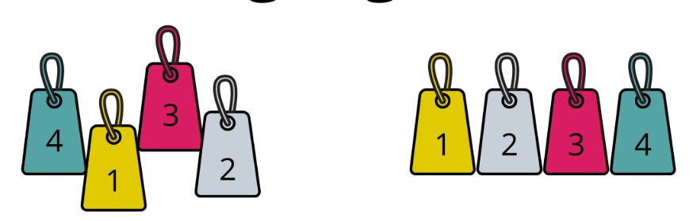

ALGORITHM ADVANCED
W3-S1 – Sorting Algorithms

Slide 3


Session Objectives
Understand 3 sorting approaches
Selection
Insertion
Bubble
Evaluate each algorithm complexity (in time and space)

Slide 4

Notes:
Insertion sort Selection sort
Merge sort Bubble sort

Slide 5


GAME
THE SORTING SHOW
X 05
30min
Group of 05 students
Each group is responsible of 1 sorting algorithm (Selection Insertion Bubble)
1 - PREPARATION
20 min : learn the sorting algorithm
Use internet, video etc..
Everyone in your group should understand
10 min : Prepare the show !
2 - SHOW
Every group present their show
Stand in a line and sort yourselves according to your cards
A speaker can explain the steps
1
4
3
2
DEMO : stand in a line and sort yourselves according to your cards number without speaking.

Slide 6
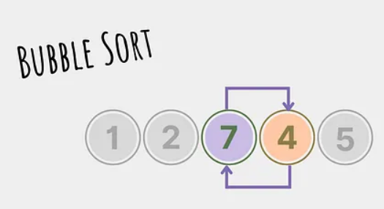
EXPLAIN
Bubble sort

Slide 7


EXPLAIN
Bubble sort
The Unordered list (by Height) Baseball Team
The Ordered list (by Height) Baseball Team

Slide 8
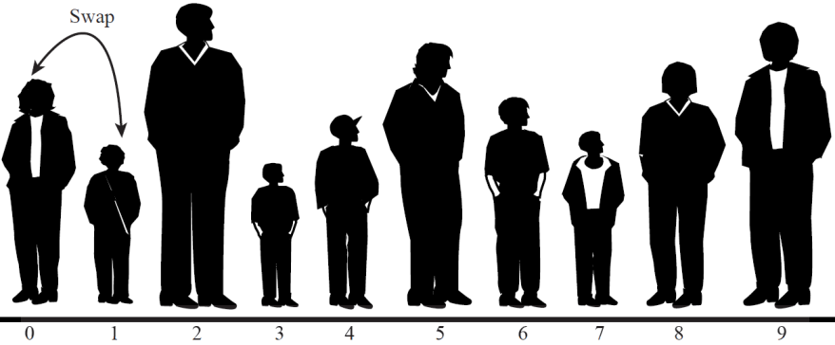
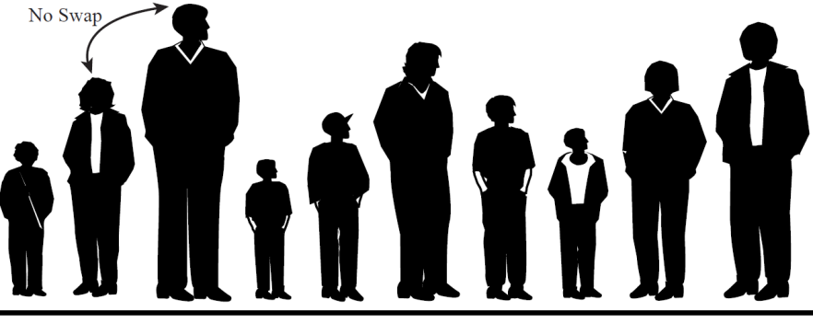
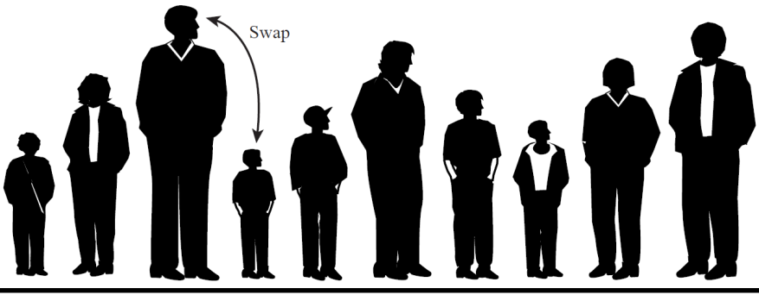

EXPLAIN
1st Pass of Bubble Short
Initial step
Start from left to right
Compare the two players in position 0 and 1
Compare-and-swap
If the player in position 0 > player in position 1 , swap them.
Else: do nothing;
Move Next
move over one position
compare the players in positions 1 and 2.
if the player left is taller, swap them.
Taller

Slide 9

EXPLAIN
A cycle of Bubble Short
The tallest player will be swapped every time
he (or she) will reach the right end of the line
After this first pass, it was (n-1) comparisons
n – number of players), and somewhere 0 and (n-1) swaps
The player at the end of the array is sorted and won’t be moved again
Go back to the left end of the line
Compare player 0 and 1 again, and so on to the right
At 2nd pass, it will stop at position (n-2)
Continue this process until all the players are in order.
End of First Pass

Slide 10
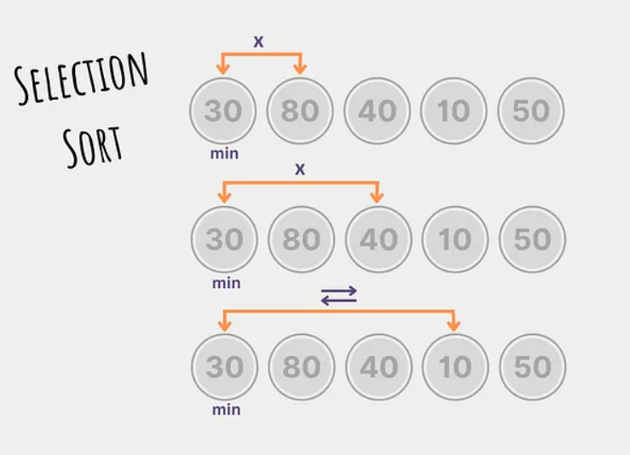
EXPLAIN
Selection sort

Slide 12
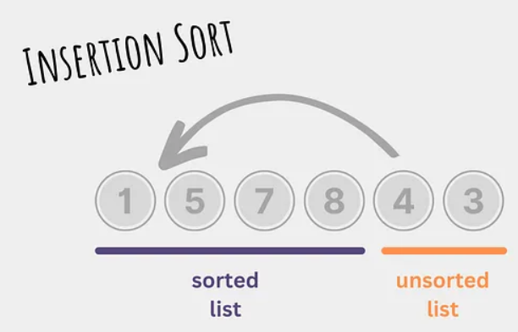
EXPLAIN
Insertion sort

Slide 16
EXERCICES

Slide 17
Other Resource
Resources for sorting algorithm:
1) Introduction to sorting algorithms
https://www.youtube.com/watch?v=5W2lfiCA1HU
2) Playlist for sorting algo (animiated and code function)
https://www.youtube.com/watch?v=MtQL_ll5KhQ&list=PLqM7alHXFySHrGIxeBOo4-mKO4H8j2knW
3) Playlist for sorting algo
https://www.youtube.com/watch?v=GUDLRan2DWM&list=PL2_aWCzGMAwKedT2KfDMB9YA5DgASZb3U&index=2
4) Built-in C++ library for sorting
https://www.youtube.com/watch?v=x0uUKWJzSO4

Slide 18
You should know…
Understand 3 sorting approaches
Selection
Insertion
Bubble
Evaluate each algorithm complexity (in time and space)

Slide 19



WRAPPING THE LESSON
3-2-1 Challenge
List three things you learned today.
List two questions you still have.
List one aspect of the lesson or topic you enjoyed.

